Slide 1
Text Summarization
Created
By
Anjana Tiha

Slide 2
Extraction Based Summarization

Slide 3
Word Based Scoring Technique
Word Frequency:
More frequent words in a document -> greater importance.
Higher scores to important words.
More likely to be included in the summery.
Sentence Inclusion of Numerical Data:
Sentences containing numerical data is considered important.
More likely to be included in the document summary.
Lexical Similarity:
Important sentences are identified by strong chains.
Proper Noun:
Higher number of proper nouns are more important.
More weight for sentences having more proper nouns.

Slide 4
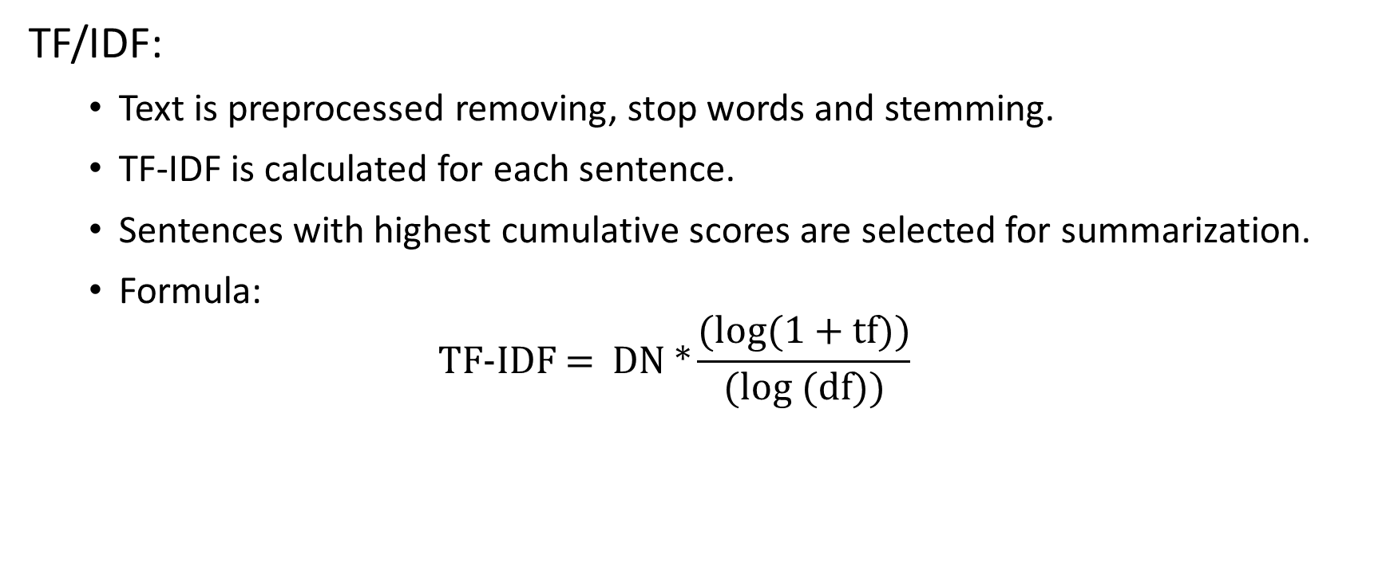
Word Based Scoring Technique
TF/IDF:
Text is preprocessed removing, stop words and stemming.
TF-IDF is calculated for each sentence.
Sentences with highest cumulative scores are selected for summarization.
Formula:
$$\text{TF}\text{-}\text{IDF}\text{ = }\text{DN}\text{ *}\frac{\text{(}\text{log}\text{(1 + }\text{tf}\text{))}}{\text{(}\text{log}\text{ (}\text{df}\text{))}}$$

Slide 5
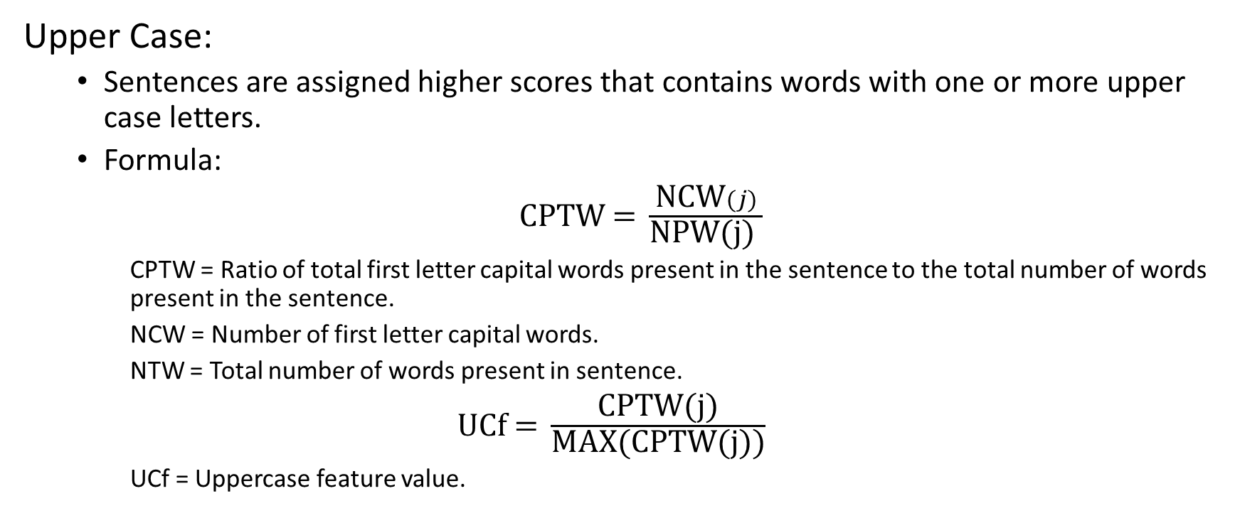
Word Based Scoring Technique
Upper Case:
Sentences are assigned higher scores that contains words with one or more upper case letters.
Formula:
$\text{CPTW}\text{ = }\frac{\text{NCW}(j)}{\text{NPW}\text{(}\text{j}\text{) }}$
CPTW = Ratio of total first letter capital words present in the sentence to the total number of words present in the sentence.
NCW = Number of first letter capital words.
NTW = Total number of words present in sentence.
$\text{UCf}\text{ = }\frac{\text{CPTW}\text{(}\text{j}\text{)}}{\text{MAX}\text{(}\text{CPTW}\text{(}\text{j}\text{))}}$
UCf = Uppercase feature value.

Slide 6
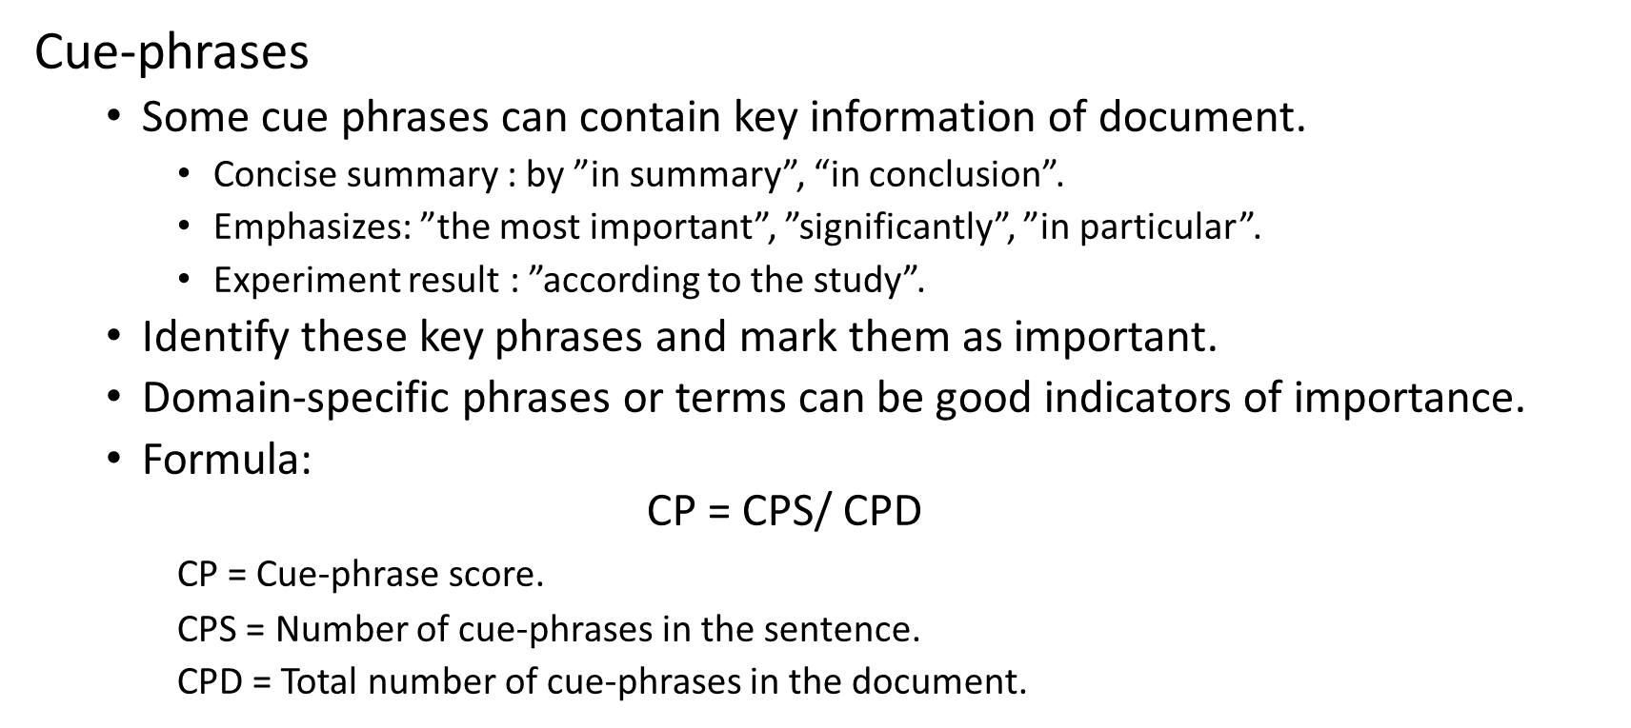
Sentence Based Scoring Technique
Cue-phrases
Some cue phrases can contain key information of document.
Concise summary : by ”in summary”, “in conclusion”.
Emphasizes: ”the most important”, ”significantly”, ”in particular”.
Experiment result : ”according to the study”.
Identify these key phrases and mark them as important.
Domain-specific phrases or terms can be good indicators of importance.
Formula:
$$\text{CP}\text{ = }\text{CPS}\text{/ }\text{CPD}$$
CP = Cue-phrase score.
CPS = Number of cue-phrases in the sentence.
CPD = Total number of cue-phrases in the document.

Slide 7
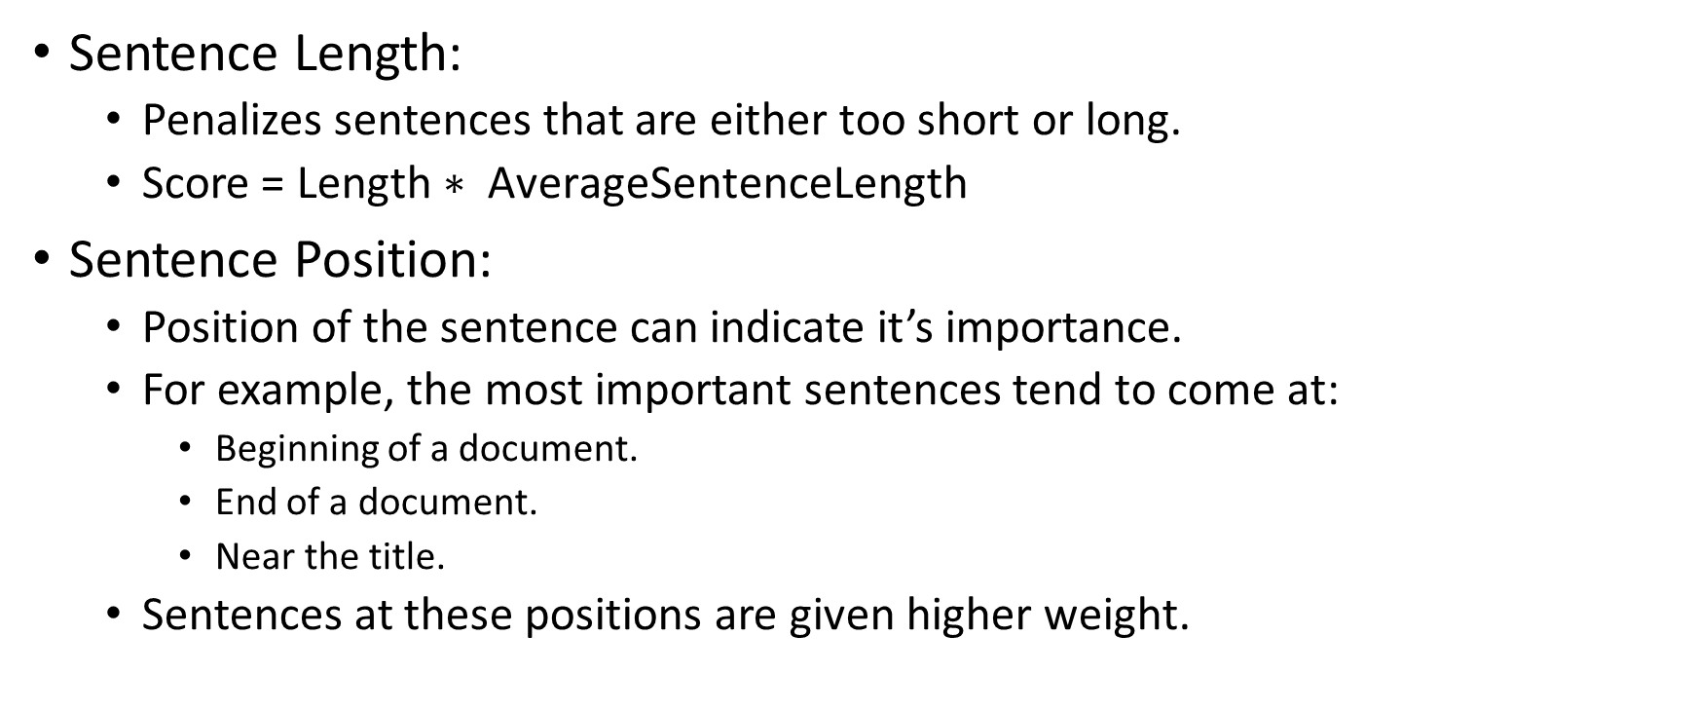
Sentence Based Scoring Technique
Sentence Length:
Penalizes sentences that are either too short or long.
$\text{Score}\text{ = }\text{Length}\text{ ∗ }\text{AverageSentenceLength}$
Sentence Position:
Position of the sentence can indicate it’s importance.
For example, the most important sentences tend to come at:
Beginning of a document.
End of a document.
Near the title.
Sentences at these positions are given higher weight.

Slide 8
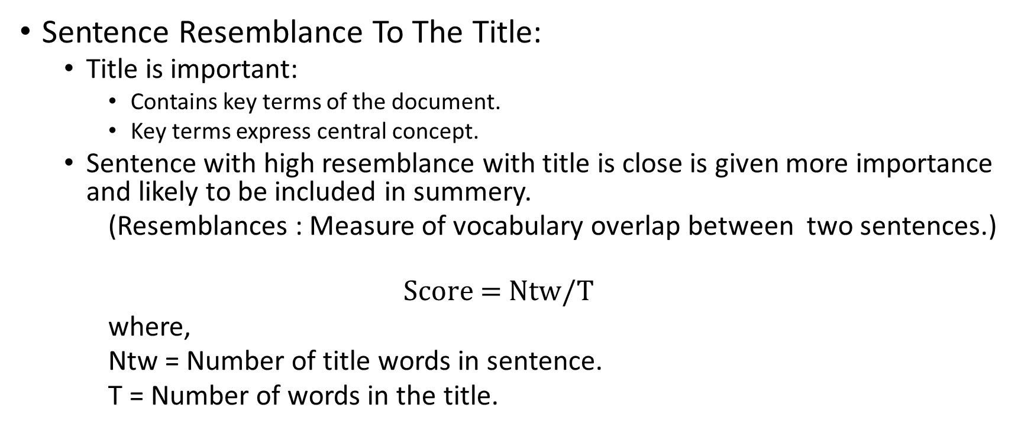
Sentence Based Scoring Technique
Sentence Resemblance To The Title:
Title is important:
Contains key terms of the document.
Key terms express central concept.
Sentence with high resemblance with title is close is given more importance and likely to be included in summery.
(Resemblances : Measure of vocabulary overlap between two sentences.)
$$\text{Score}\text{ = }\text{Ntw}\text{/}\text{T}$$
where,
Ntw = Number of title words in sentence.
T = Number of words in the title.

Slide 9
Graph Based Scoring Technique
Graph-based Scoring:
Analyzes relationship among sentences in a document.
All the sentences are considered a node in a graph.
Two nodes are connected based on shared attribute or similar information like overlapping vocabulary.
Nodes (sentences) with higher cardinality is considered more important for summarization.
Method:
Preprocessing:
Text is preprocessed by removing digits, special characters, stop words and converting them to lower case.
After initial preprocessing, stemming is done to reduce to root words.
When a sentence refers to another
Generates a link between them
Associates weight between them.
Weights are used to generating the scores of a sentence.

Slide 10
Extraction-based summarization (Graph Based Scoring )
Cluster based method:
Documents have an inherent organizational pattern.
Key information’s are placed strategically in a document.
Some part of the document may contain more comprehensive information than other parts.
Method:
Each document is divided into multiple segments or clusters.
Each objects (word, sentence) in each segment are given weights.
based on term importance, TF-IDF or other features.
Generate cumulative score for all the objects present in each segment.
Segments are ranked according to the overall importance score.
Segments with highest scores are selected for summary.

Slide 11
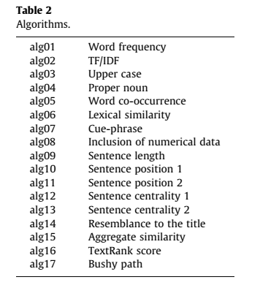
Scoring Method Comparison
Source: Assessing sentence scoring techniques for extractive text summarization
Rafael Ferreira a, Luciano de Souza Cabral
(Expert Systems with Applications)

Slide 12
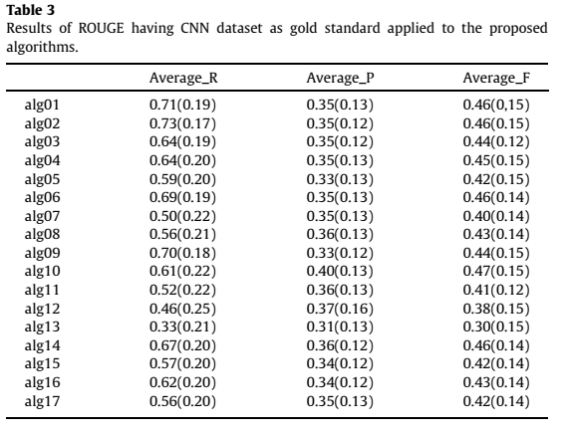
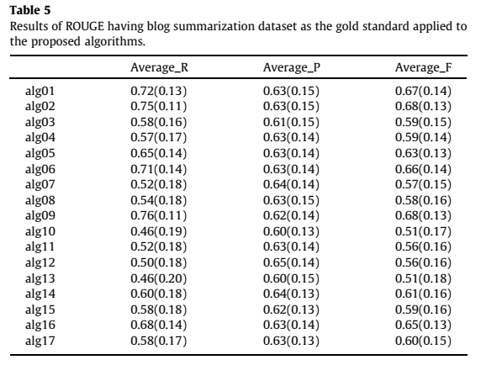
Scoring Method Comparison

Slide 13
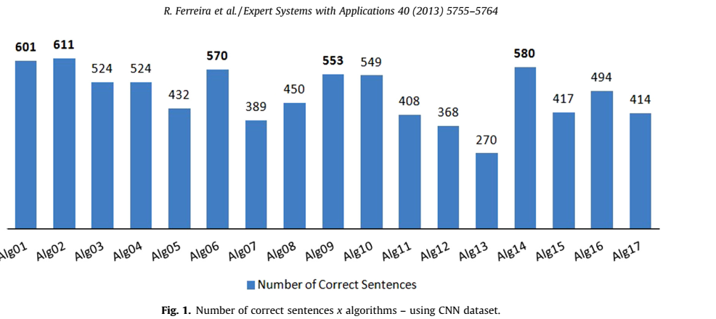
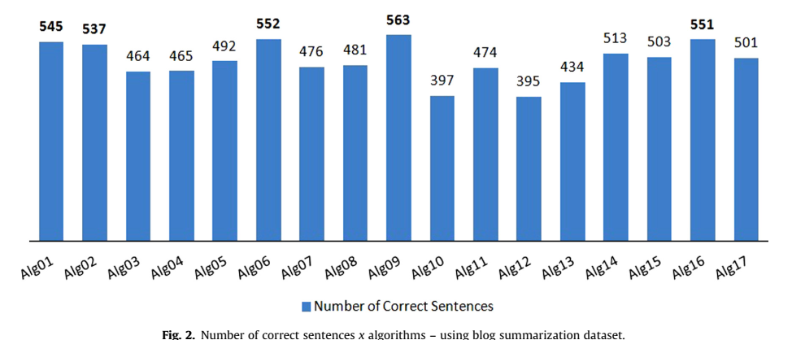
Performance Comparison

Slide 14
Result
Following techniques scored better:
Word Frequency
TF-IDF
Sentence Length

Slide 15
Challenges of Extractive Summarization
Lack of coherency.
Summery or unit sentences can be too long to understand the concept accurately.
Contains counter information and lead to ambiguity and confusion.
Key information could get ignored due to selection of scoring method.

Slide 16
Abstractive Summarization Technique

Slide 17
Abstractive Summarization Technique
Abstractive summarization system paraphrases segments of the source document.
Improves the coherence among sentences by eliminating redundancies and clarifying the contest of sentences.
Advantage:
Abstraction based techniques can generate more condensed text than extraction techniques.
Requires usage of natural language generation technology, which is still in growth stage.
Majority of summarization systems are using extractive methods.

